Slide 1


دومین دورهمی گروه کاربران لینوکس تعبیه شده E-LUG ) (
Rust in Embedded System (Advantages & Applications) By: M. Moslemi AbarGhan
28 فروردین ماه 1403

Slide 2
Contents of This Presentation
Memory Safety
Concurrency and Asynchronous Programming
Zero-cost Abstractions
Static Typing
Minimal Runtime
Instructions for use.
Cargo Package Manager
Integration with C
Unsafe Code

Slide 3
Memory Safety

Slide 4
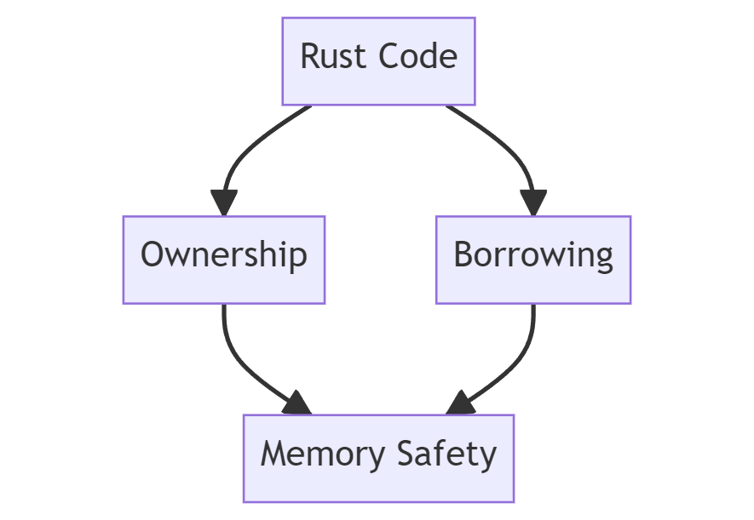
Memory Safety
Rust ensures memory safety without sacrificing performance by using ownership, borrowing, and lifetimes.

Slide 5
Memory Safety
Rust ensures memory safety without sacrificing performance, which is crucial for embedded systems where memory management errors can lead to system crashes or vulnerabilities.
fn main() {
let mut data = [0u8; 10]; // Initialize an array with 10 elements
data[15] = 42; // This will cause a compile-time error due to array bounds checking
}

Slide 6
Concurrency and Asynchronous Programming

Slide 7
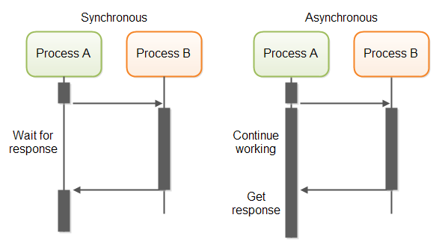
Concurrency and Asynchronous Programming
Rust provides built-in support for concurrency with features like threads, message passing, and the `async/await` syntax for asynchronous programming.

Slide 8
Concurrency and Asynchronous Programming
Rust provides built-in support for concurrency and asynchronous programming, allowing developers to take advantage of multicore processors and handle asynchronous events efficiently in embedded systems.
use std::thread;
fn main() {
let handle = thread::spawn(|| {
// Code to be executed in a separate thread
println!("Hello from another thread!");
});
// Wait for the thread to finish execution
handle.join().unwrap();
}

Slide 9
Zero-cost Abstractions

Slide 10
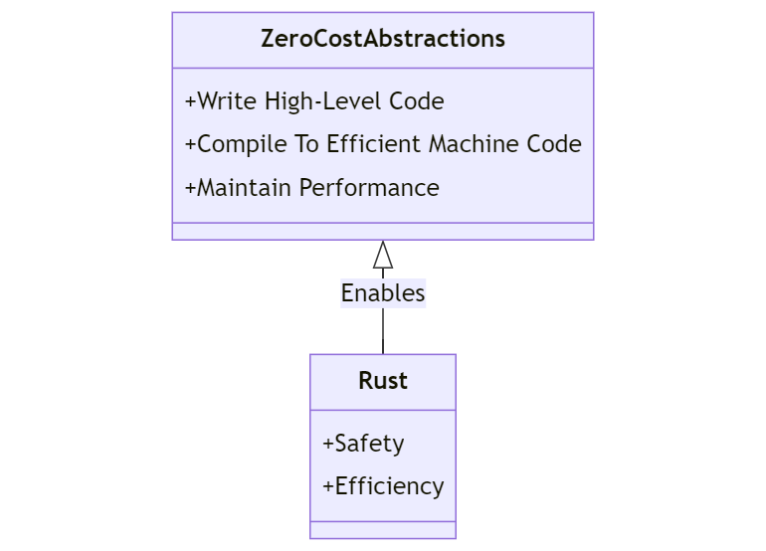
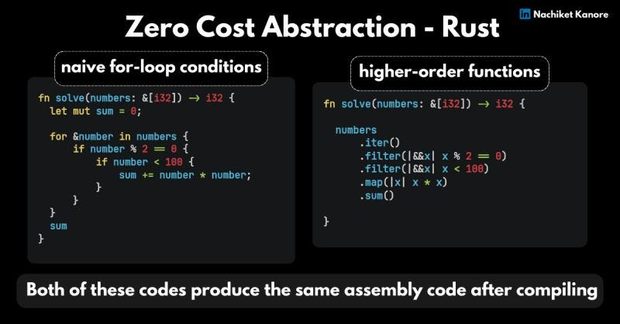
Zero-cost Abstractions
Rust allows developers to write high-level code without incurring runtime overhead, thanks to its emphasis on zero-cost abstractions.

Slide 11
Zero-cost Abstractions
Rust's zero-cost abstractions allow developers to write high-level code without incurring runtime overhead, which is important for embedded systems where efficiency is paramount.
fn main() {
let result = 10 + add_numbers(20, 30); // No runtime overhead for the function call
println!("Result: {}", result);
}
fn add_numbers(a: i32, b: i32) -> i32 {
a + b
}

Slide 12
Static Typing

Slide 13
Static Typing
Rust is a statically typed language, which means that it checks your program's types at compile-time. But unlike other such languages, it also features a powerful feature called type inference that makes Rust more convenient and easier to use.

Slide 14
Static Typing
Rust's strong static typing system helps catch errors at compile-time, reducing the likelihood of runtime errors in embedded systems.
fn main() {
let x: i32 = "hello"; // This will cause a compile-time error due to type mismatch
println!("x: {}", x);
}

Slide 15
Minimal Runtime

Slide 16
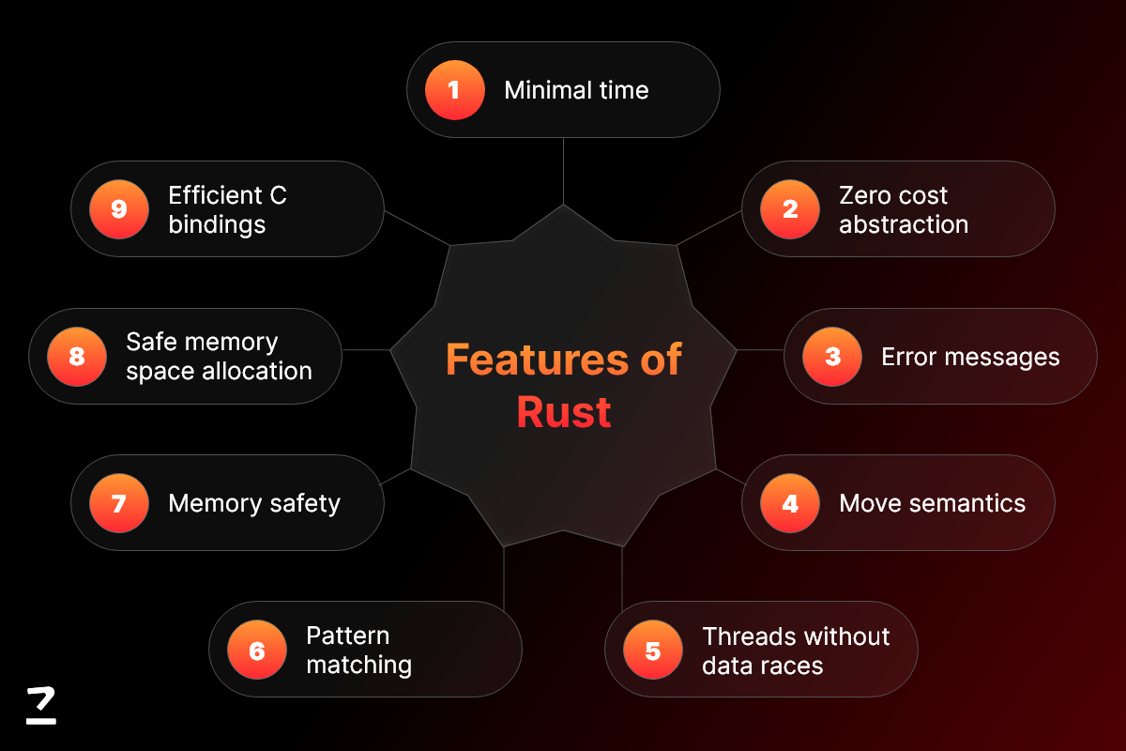
Minimal Runtime
Rust makes better sense to achieve more performance and energy saving by it’s minimal runtime.

Slide 17
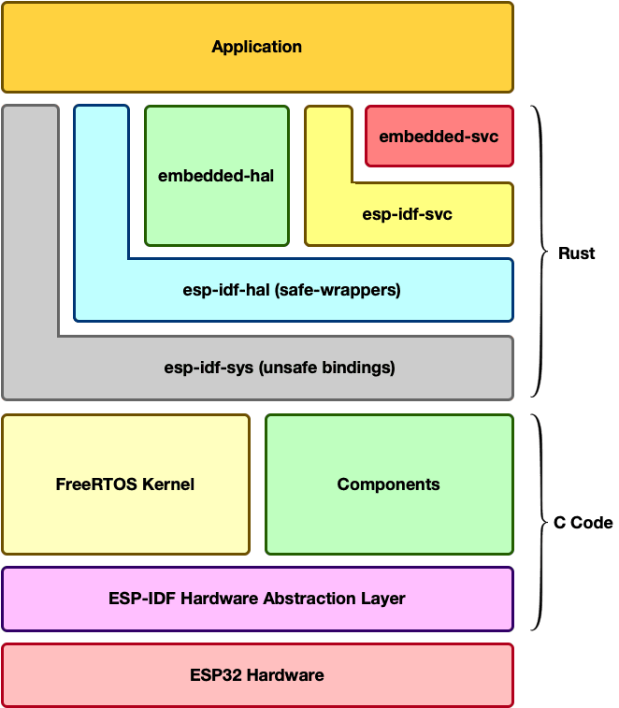
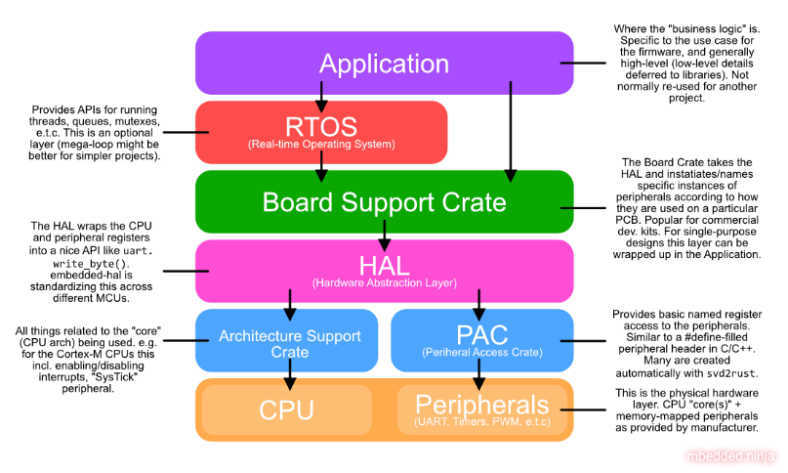
Minimal Runtime
Rust's minimal runtime makes it suitable for embedded systems with limited resources, as it doesn't require a large runtime environment like some other languages.

Slide 18
Cargo Package Manager

Slide 19
Cargo Package Manager
Rust comes with Cargo, a powerful package manager and build system that simplifies dependency management and project.

Slide 20

Cargo Package Manager
Rust's Cargo build system simplifies dependency management and project configuration, making it easier to manage complex embedded systems projects.

Slide 21
Integration with C

Slide 22
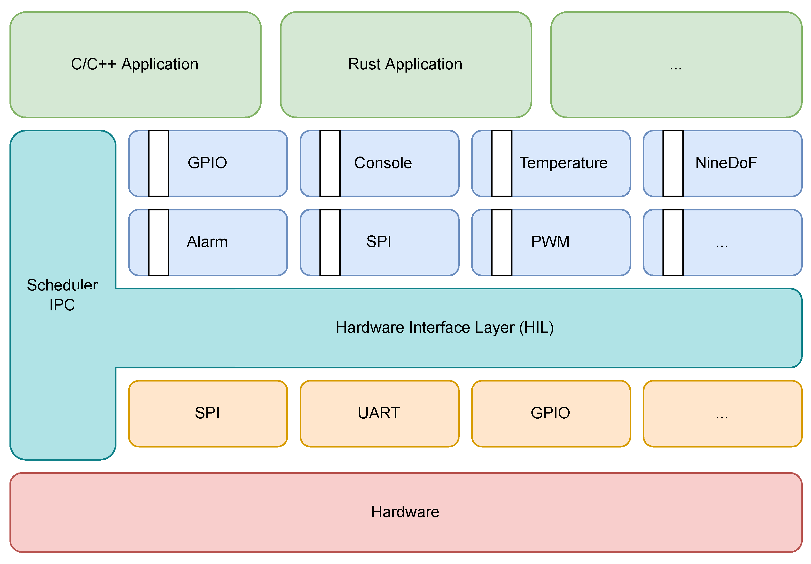
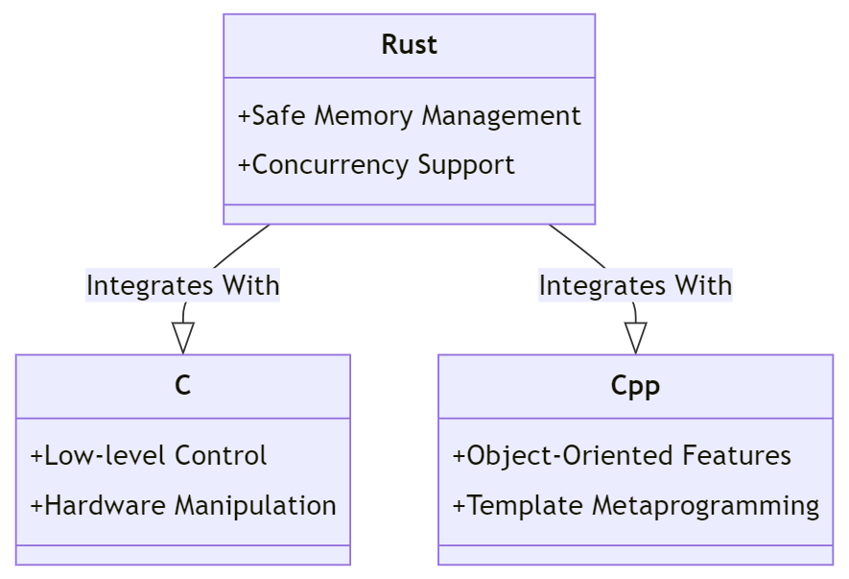
Integration with C
Using Rust code inside a C or C++ project mostly consists of two parts:
1) Creating a C-friendly API in Rust
2) Embedding your Rust project into an external build system

Slide 23
Integration with C
Rust can easily integrate with existing C code, which is commonly used in embedded systems development, allowing developers to leverage existing libraries and infrastructure.
extern crate libc;
fn main() {
unsafe {
// Call a C function from Rust
libc::puts("Hello from C");
}
}

Slide 24
Unsafe Code

Slide 25
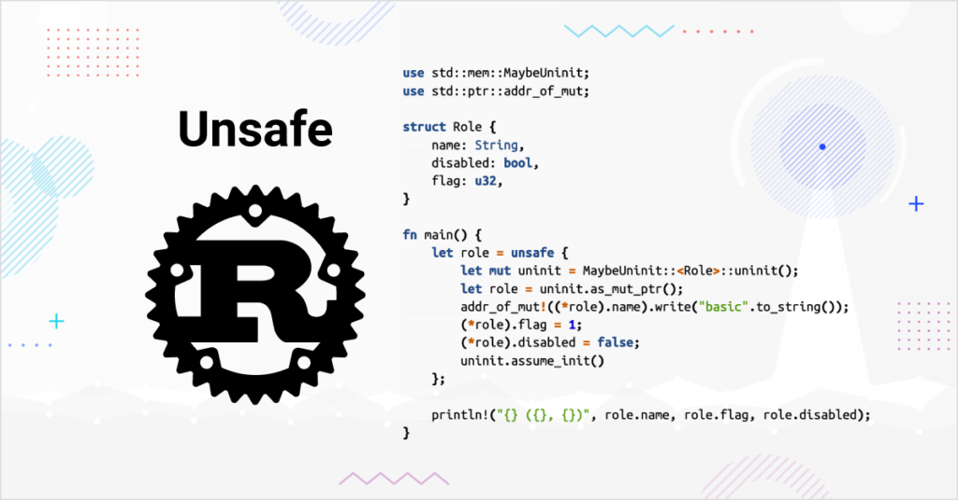
Unsafe Code
Rust allows writing unsafe code when necessary for performance or interfacing with low-level systems, but provides tools to encapsulate and isolate unsafe operations.

Slide 26
Unsafe Code
While unsafe code should be used judiciously, Rust allows developers to write low-level code when necessary for interacting with hardware or optimizing performance in embedded systems.
fn main() {
let mut data = [0u8; 10];
unsafe {
// Perform unsafe operations such as dereferencing raw pointers
*data.as_mut_ptr().offset(15) = 42;
}
}

Slide 27
References
- www.Wikipedia.org

Slide 28





با تشکر
ما را در شبکه های اجتماعی دنبال کنید:

